Slide 1




www.caraway.com/home
Explore
C
Register
Login
araway
About
Caraway…
Many female students don’t have the resources they need to handle their stress through access to therapists. Caraway provides immediate access to these professionals through their app and help with getting virtual appointments
Notes:
Dark slate grey: #305252 Ash grey: #BFC8AD Mountbatten pink: #A28497
Redwood: #A96060 Mayablue: #79BEEE

Slide 2

www.caraway.com/home
Explore
C
Register
Login
araway
About
Caraway…
Many female students don’t have the resources they need to handle their stress through access to therapists. Caraway provides immediate access to these professionals through their app and help with getting virtual appointments
Learn about Sara!
Sara is a second-year Computer Science foreign student and is also working part-time as a TA. She struggled to balance her school and personal life while having to work on the side. Caraway helped her find a therapist that could work on her schedule, and give her tips!
Notes:
Dark slate grey: #305252 Ash grey: #BFC8AD Mountbatten pink: #A28497
Redwood: #A96060 Mayablue: #79BEEE

Slide 3

www.caraway.com/home
Explore
C
Register
Login
araway
Sara is a second-year Computer Science foreign student and is also working part-time as a TA. She struggled to balance her school and personal life while having to work on the side. Caraway helped her find a therapist that could work on her schedule, and give her tips!
Learn about Jaleesa!
Jaleesa is a junior majoring in Chemical Engineering. During the weekends, she works part time as barista at her local coffee shop. In her free time she likes to explore the city with her friends and catch up on her favorite tv series. As a full time student, balancing her social life, work and grades is frustrating. After using Caraway, she was able to find resources to help her learn how to manage her responsibilities and still have time for herself.
Notes:
Dark slate grey: #305252 Ash grey: #BFC8AD Mountbatten pink: #A28497
Redwood: #A96060 Mayablue: #79BEEE

Slide 4



Learn about Jaleesa!
www.caraway.com/home
Jaleesa is a junior majoring in Chemical Engineering. During the weekends, she works part time as barista at her local coffee shop. In her free time she likes to explore the city with her friends and catch up on her favorite tv series. As a full time student, balancing her social life, work and grades is frustrating. After using Caraway, she was able to find resources to help her learn how to manage her responsibilities and still have time for herself.
Explore
C
Register
Login
araway
Sign up for our newsletter!
email
Submit
Careers | FAQ | Contact Us | Press
Notes:
Dark slate grey: #305252 Ash grey: #BFC8AD Mountbatten pink: #A28497
Redwood: #A96060 Mayablue: #79BEEE

Slide 5
Learn about Jaleesa!
www.caraway.com/newsletter
Explore
C
Register
Login
araway
Thank you for subscribing to our newsletter! Be on the look-out for information soon!
Careers | FAQ | Contact Us | Press
Notes:
Dark slate grey: #305252 Ash grey: #BFC8AD Mountbatten pink: #A28497
Redwood: #A96060 Mayablue: #79BEEE

Slide 6
www.caraway.com/home
Explore Menu
C
Register
Login
araway
Home
Management Tips
Blog
Meet Therapists
Financial Aid Programs
Many female students don’t have the resources they need to handle their stress through access to therapists. Caraway provides immediate access to these professionals through their app and help with getting virtual appointments
Login
Contact Us
Notes:
Dark slate grey: #305252 Ash grey: #BFC8AD Mountbatten pink: #A28497
Redwood: #A96060 Mayablue: #79BEEE

Slide 7
www.caraway.com/management-tip
Explore
C
Register
Login
araway
Management Tips
Find management tips recommended for you according to your needs!
Start Questionnaire
Notes:
Dark slate grey: #305252 Ash grey: #BFC8AD Mountbatten pink: #A28497
Redwood: #A96060 Mayablue: #79BEEE

Slide 8
www.caraway.com/management-tip
Explore
C
Register
Login
araway
Management Tips
How would you rate your time management skills?
1
2
3
4
5
I’m unsatisfied
I’m satisfied
Progress…
Next
Notes:
Dark slate grey: #305252 Ash grey: #BFC8AD Mountbatten pink: #A28497
Redwood: #A96060 Mayablue: #79BEEE

Slide 9
www.caraway.com/management-tip
Explore
C
Register
Login
araway
Management Tips
I have activities I can do to help me cope with stress
1
2
3
4
5
I don’t have any
I have go tos that I use often
Back
Progress…
Next
Notes:
Dark slate grey: #305252 Ash grey: #BFC8AD Mountbatten pink: #A28497
Redwood: #A96060 Mayablue: #79BEEE

Slide 10
www.caraway.com/management-tips
Explore
C
Register
Login
araway
Management Tips
I feel stressed often
1
2
3
4
5
Too Often
I never feel stressed
Back
Progress…
Next
Notes:
Dark slate grey: #305252 Ash grey: #BFC8AD Mountbatten pink: #A28497
Redwood: #A96060 Mayablue: #79BEEE

Slide 11
www.caraway.com/management-tips
Explore
C
Register
Login
araway
Management Tips
I have multiple sources of stress in my life
1
2
3
4
5
I disagree
I agree
Back
Progress…
Done
Notes:
Dark slate grey: #305252 Ash grey: #BFC8AD Mountbatten pink: #A28497
Redwood: #A96060 Mayablue: #79BEEE

Slide 12

www.caraway.com/management-tips
Explore
C
Register
Login
araway
Management Tips
Thank you for completing our questionnaire! Browse our recommended management tips!
Tips On Balancing School Work and Life
10 Ways to Manage feeling Anxious
Having a hard time with school, work and trying to have a social life? Look at these tips to help balance them
Feeling anxious and don’t know how to slow down? Try out one of these 10 tips
Notes:
Dark slate grey: #305252 Ash grey: #BFC8AD Mountbatten pink: #A28497
Redwood: #A96060 Mayablue: #79BEEE

Slide 13

www.caraway.com/management-tips
Explore
C
Register
Login
araway
Blogs
Topics to Explore
Notes:
Dark slate grey: #305252 Ash grey: #BFC8AD Mountbatten pink: #A28497
Redwood: #A96060 Mayablue: #79BEEE

Slide 14
www.caraway.com/management-tips
Explore
C
Register
Login
araway
Topics to Explore
Mental Health
Therapy
Affordable therapy for students who may be facing financial constraints.
Designed for young student parents access affordable therapy
Explore Mental Health
Explore Therapy Options
Practicals to Try
Helping Loved Ones
Affordable therapy for students who may be facing financial constraints.
Affordable therapy to students for low income students
Explore Practicals
Explore How to Help Loved Ones
Notes:
Dark slate grey: #305252 Ash grey: #BFC8AD Mountbatten pink: #A28497
Redwood: #A96060 Mayablue: #79BEEE

Slide 15

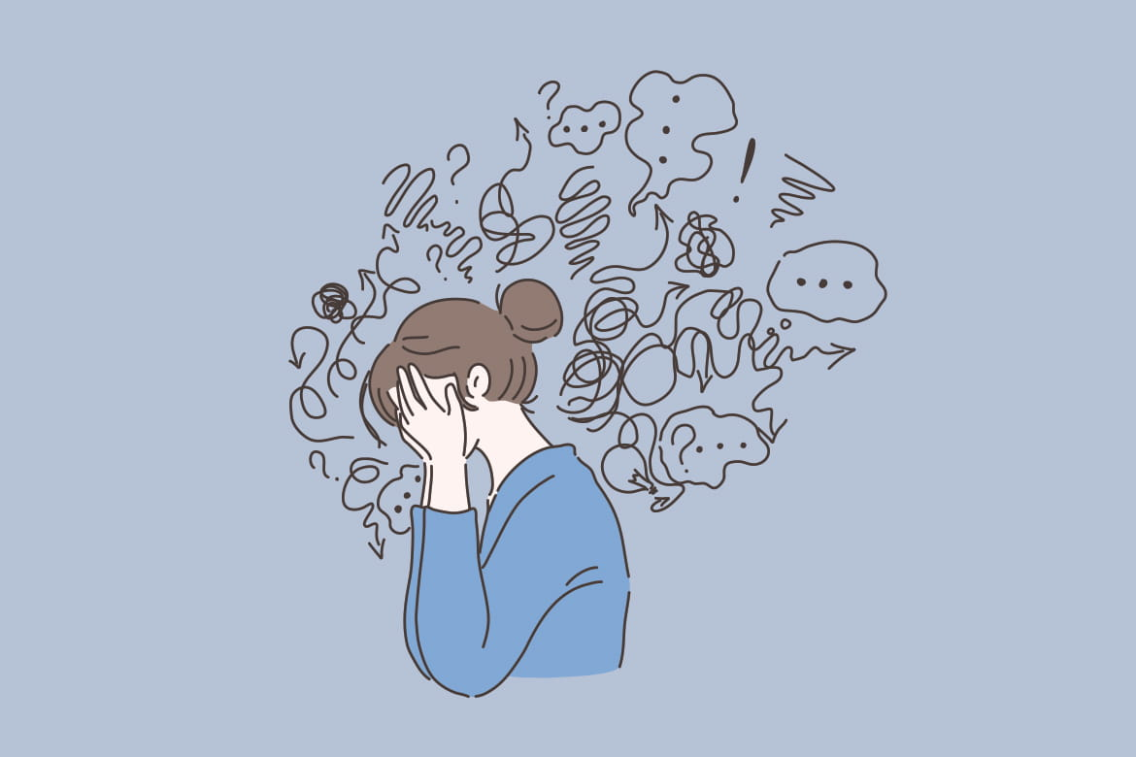


www.caraway.com/management-tips
Explore
C
Register
Login
araway
Popular Stories…
Understanding Stress
Finding Balance
Prioritizing
Breathing tips for Anxiety
It’s easy to overload yourself, or naturally have a lot on your plate. Learn how to manage it here
What is stress? What causes it? How can you work through it? Check out the article to learn more
Having a hard time doing work for school and work to pay for school? Look here for tips!
Everyone gets anxiety! There are many things you can try, but breathing exercises prove to be the most helpful. Learn some helpful ones here!
Sign up for our newsletter!
email
Submit
Careers | FAQ | Contact Us | Press
Notes:
Dark slate grey: #305252 Ash grey: #BFC8AD Mountbatten pink: #A28497
Redwood: #A96060 Mayablue: #79BEEE

Slide 16

www.caraway.com/financial-assistance
Explore
C
Register
Login
araway
Financial Assistance Programs
Our Financial Assistance Programs are designed to provide students with affordable and accessible medical coverage. We understand that healthcare costs can be a significant financial burden for students, and that is why we offer a student discount program that is tailored to their income. Our aim is to ensure that every student has access to the healthcare they need, regardless of their financial circumstances. With our financial assistance program, students can rest assured that they will receive top-quality medical care at an affordable cost. Explore our website to learn more about our program and how it can benefit you.
Notes:
Dark slate grey: #305252 Ash grey: #BFC8AD Mountbatten pink: #A28497
Redwood: #A96060 Mayablue: #79BEEE

Slide 17
www.caraway.com/financial-assistance
Explore
C
Register
Login
araway
Programs to Explore
Student Discount
Young Parent Discount
Affordable therapy for students who may be facing financial constraints.
Designed for young student parents access affordable therapy
Explore Student Discount
Explore Young Parent Discount
Family Discount
Low Income Discount
Affordable therapy for students who may be facing financial constraints.
Affordable therapy to students for low income students
Explore Family Discount
Explore Low Income Discount
Notes:
Dark slate grey: #305252 Ash grey: #BFC8AD Mountbatten pink: #A28497
Redwood: #A96060 Mayablue: #79BEEE

Slide 18




www.caraway.com/financial-assistance
Explore
C
Register
Login
araway
Past Experiences…
We hope that these stories will provide insight into how these programs can be a valuable resource for those seeking therapy, and inspire others to seek the care they need for themselves. Whether you are a student, a young parent, or a member of a family, we believe that everyone deserves access to high-quality mental health care, regardless of their financial circumstances.
Lily
Sydney
Jayla
Camila
As a student, finances are always a concern, and therapy sessions can be a significant expense. However, with this discount program, I was able to access high-quality therapy services at a reduced cost.
The student discount program was a life-saver. The program was easy to use, affordable, and I was able to connect with a therapist who was skilled and compassionate.
The affordability of the program made it accessible to me and the community support was incredibly valuable. My therapist was knowledgeable, supportive, and helped me gain the tools I needed to manage my mental health
The therapy discount program for women college students is a fantastic resource for those who are looking for affordable mental health care. This program offers a safe space for women to talk to licensed therapists and access mental health services at a discounted rate.
Notes:
Dark slate grey: #305252 Ash grey: #BFC8AD Mountbatten pink: #A28497
Redwood: #A96060 Mayablue: #79BEEE

Slide 19
www.caraway.com/financial-assistance
We hope that these stories will provide insight into how these programs can be a valuable resource for those seeking therapy, and inspire others to seek the care they need for themselves. Whether you are a student, a young parent, or a member of a family, we believe that everyone deserves access to high-quality mental health care, regardless of their financial circumstances.
Explore
C
Register
Login
araway
Lily
Sydney
Jayla
Camila
As a student, finances are always a concern, and therapy sessions can be a significant expense. However, with this discount program, I was able to access high-quality therapy services at a reduced cost.
The student discount program was a life-saver. The program was easy to use, affordable, and I was able to connect with a therapist who was skilled and compassionate.
The affordability of the program made it accessible to me and the community support was incredibly valuable. My therapist was knowledgeable, supportive, and helped me gain the tools I needed to manage my mental health
The therapy discount program for women college students is a fantastic resource for those who are looking for affordable mental health care. This program offers a safe space for women to talk to licensed therapists and access mental health services at a discounted rate.
Sign up for our newsletter!
email
Submit
Careers | FAQ | Contact Us | Press
Notes:
Dark slate grey: #305252 Ash grey: #BFC8AD Mountbatten pink: #A28497
Redwood: #A96060 Mayablue: #79BEEE

Slide 20
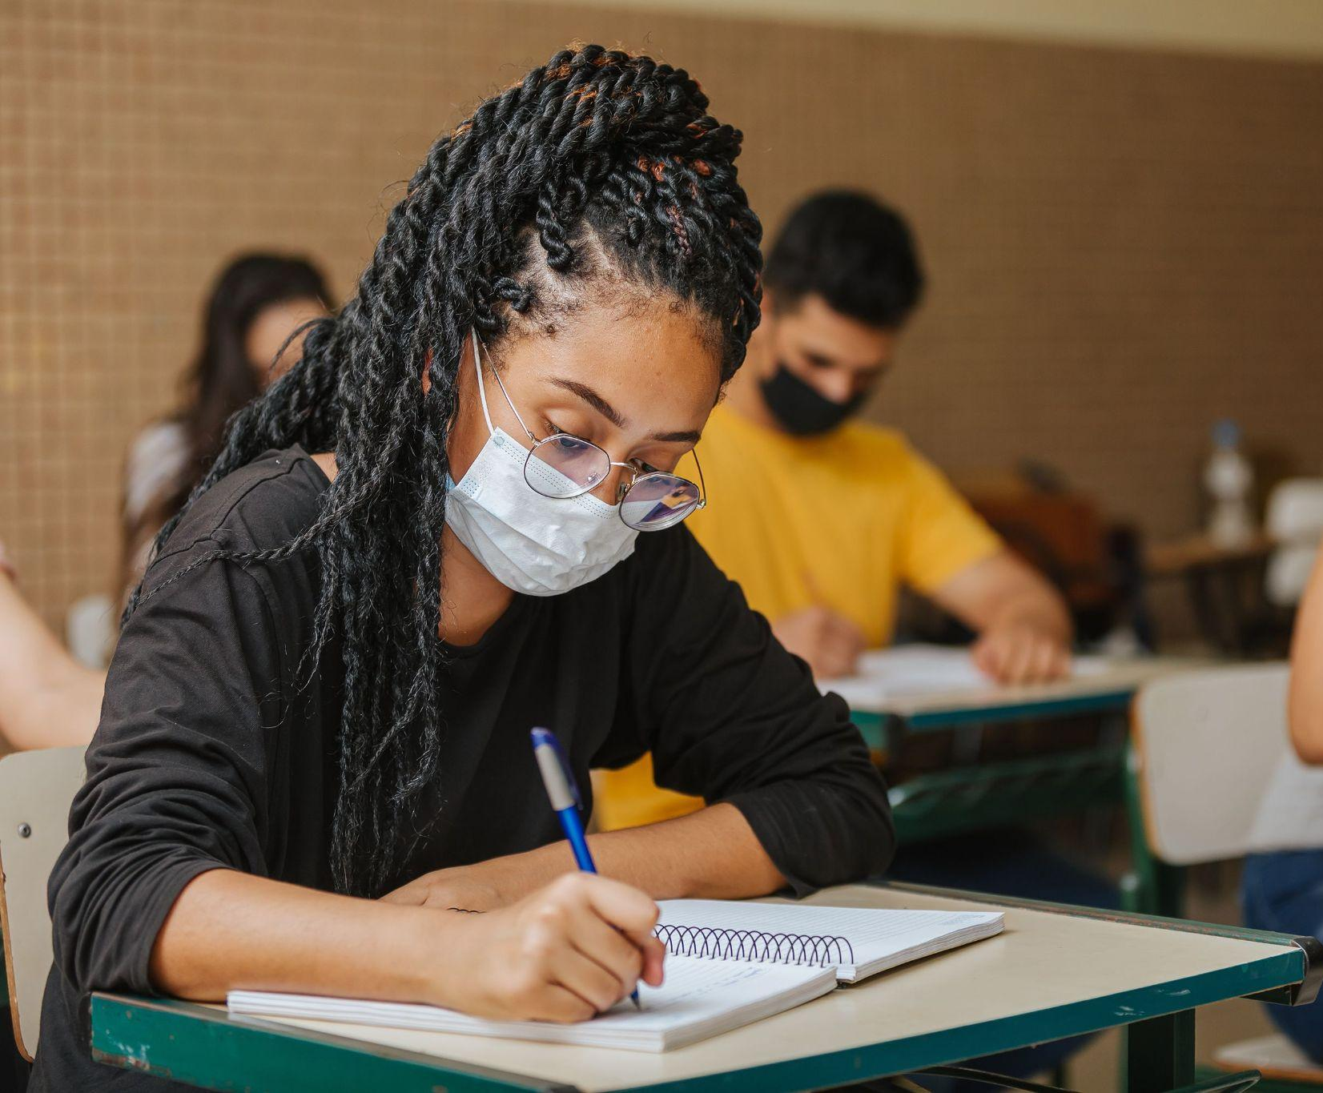
www.caraway.com/financial-assistance/students
Explore
C
Register
Login
araway
Student-Program
Students of certain filing status and age can get different amounts of financial help based on their eligibility! See below to know what you qualify for, and contact us to see about applying your discount to your first visit!
Independent Student | $200 off
Dependent Student | $100 off
Seniors | $50 off additionally
Contact Us!
Notes:
Dark slate grey: #305252 Ash grey: #BFC8AD Mountbatten pink: #A28497
Redwood: #A96060 Mayablue: #79BEEE

Slide 21
Students of certain filing status and age can get different amounts of financial help based on their eligibility! See below to know what you qualify for, and contact us to see about applying your discount to your first visit!
www.caraway.com/financial-assistance/students
Explore
C
Register
Login
araway
Independent Student | $200 off
Dependent Student | $100 off
Seniors | $50 off additionally
Contact Us!
Sign up for our newsletter!
email
Submit
Careers | FAQ | Contact Us | Press
Notes:
Dark slate grey: #305252 Ash grey: #BFC8AD Mountbatten pink: #A28497
Redwood: #A96060 Mayablue: #79BEEE

Slide 22

www.caraway.com/financial-assistance/families
Explore
C
Register
Login
araway
Family-Program
Families of different sizes and financial situations can see about getting different amounts of financial aid. Mother must qualify as a college student, whether full or part-time. See below to know what you qualify for, and contact us to see about applying your discount to your first visit!
Family of 5 (all under 30) | $300 off
Family of 4 (all under 30) | $250 off
Family of 3 (all under 30) | $200
Notes:
Dark slate grey: #305252 Ash grey: #BFC8AD Mountbatten pink: #A28497
Redwood: #A96060 Mayablue: #79BEEE

Slide 23
Families of different sizes and financial situations can see about getting different amounts of financial aid. Mother must qualify as a college student, whether full or part-time. See below to know what you qualify for, and contact us to see about applying your discount to your first visit!
www.caraway.com/financial-assistance/families
Explore
C
Register
Login
araway
Family of 5 (all under 30) | $300 off
Family of 4 (all under 30) | $250 off
Family of 3 (all under 30) | $200
Contact Us!
Sign up for our newsletter!
email
Submit
Careers | FAQ | Contact Us | Press
Notes:
Dark slate grey: #305252 Ash grey: #BFC8AD Mountbatten pink: #A28497
Redwood: #A96060 Mayablue: #79BEEE

Slide 24

www.caraway.com/financial-assistance/young-parent
Explore
C
Register
Login
araway
Young Parent-Program
Parents whether, single or together, are able to also apply for financial aid. The parent must be a student whether full time or part time. See below to know what you qualify for, and contact us to see about applying your discount to your first visit!
Parent/Full-Time Student | $200 off
Parent/Part-Time Student | $100 off
Notes:
Dark slate grey: #305252 Ash grey: #BFC8AD Mountbatten pink: #A28497
Redwood: #A96060 Mayablue: #79BEEE

Slide 25
Young Parent-Program
www.caraway.com/financial-assistance/young-parent
Parents whether, single or together, are able to also apply for financial aid. The parent must be a student whether full time or part time. See below to know what you qualify for, and contact us to see about applying your discount to your first visit!
Explore
C
Register
Login
araway
Parent/Full-Time Student | $200 off
Parent/Part-Time Student | $100 off
Contact Us!
Sign up for our newsletter!
email
Submit
Careers | FAQ | Contact Us | Press
Notes:
Dark slate grey: #305252 Ash grey: #BFC8AD Mountbatten pink: #A28497
Redwood: #A96060 Mayablue: #79BEEE

Slide 26

www.caraway.com/financial-assistance/low-income
Explore
C
Register
Login
araway
Low Income-Program
Those with less than average household income, can apply for financial aid through Caraway! Applicant must be a student, full time or part time. See below to know what you qualify for, and contact us to see about applying your discount to your first visit!
$40,000 or more | $100 off
$30,000-$40,000 | $200 off
$20,000-$30,000 | $300 off
$10,000-$20,000 | $350 off
Notes:
Dark slate grey: #305252 Ash grey: #BFC8AD Mountbatten pink: #A28497
Redwood: #A96060 Mayablue: #79BEEE

Slide 27
Those with less than average income, can apply for financial aid through Caraway! Applicant must be a student, full time or part time. See below to know what you qualify for, and contact us to see about applying your discount to your first visit!
www.caraway.com/financial-assistance/low-income
Explore
C
Register
Login
araway
$40,000 or more | $100 off
$30,000-$40,000 | $200 off
$20,000-$30,000 | $300 off
$10,000-$20,000 | $350 off
Contact Us!
Sign up for our newsletter!
email
Submit
Careers | FAQ | Contact Us | Press
Notes:
Dark slate grey: #305252 Ash grey: #BFC8AD Mountbatten pink: #A28497
Redwood: #A96060 Mayablue: #79BEEE

Slide 28
www.caraway.com/contact
Explore
C
Register
Login
araway
Contact Us!
Hours of Operation:
Send us an email!
Name
Mon-Fri: 8am-8pm CST
Saturday: 10am-5pm CST
Sunday: 9am-2pm CST
Email
Subject
Call us!
Office Phone: (800) - 434- 1234
Therapist Hotline: (800) - 434- 1272
Message
Submit
Notes:
Dark slate grey: #305252 Ash grey: #BFC8AD Mountbatten pink: #A28497
Redwood: #A96060 Mayablue: #79BEEE

Slide 29
www.caraway.com/contact
Explore
C
Register
Login
araway
Call us!
Office Phone: (800) - 434- 1234
Therapist Hotline: (800) - 434- 1272
Message
Submit
Careers | FAQ | Contact Us | Press
Notes:
Dark slate grey: #305252 Ash grey: #BFC8AD Mountbatten pink: #A28497
Redwood: #A96060 Mayablue: #79BEEE

Slide 30

www.caraway.com/contact
Explore
C
Register
Login
araway
Mon-Fri: 8am-8pm CST
Saturday: 10am-5pm CST
Sunday: 9am-2pm CST
Thank you submitting your email! We’ll get back to you as soon as possible!
Call us!
Office Phone: (800) - 434- 1234
Therapist Hotline: (800) - 434- 1272
Careers | FAQ | Contact Us | Press
Notes:
Dark slate grey: #305252 Ash grey: #BFC8AD Mountbatten pink: #A28497
Redwood: #A96060 Mayablue: #79BEEE

Slide 31

www.caraway.com/FAQ
Explore
C
Register
Login
araway
Frequently Asked Questions
Q: How can I schedule or cancel an appointment?
If you need to schedule an appointment, you can either call, email, or use the online booking system. You should provide your name, contact information, and a brief description of the reason for your appointment. You may also need to provide some additional details, such as your availability or insurance information.
Remember to always be polite and professional when scheduling or canceling an appointment. By doing so, you'll help ensure that the process is as smooth and hassle-free as possible for everyone involved.
Notes:
Dark slate grey: #305252 Ash grey: #BFC8AD Mountbatten pink: #A28497
Redwood: #A96060 Mayablue: #79BEEE

Slide 32
www.caraway.com/FAQ
Explore
C
Register
Login
araway
Q: How long does it take to receive a discount information?
In most cases, you should receive your discount information 5-7 business days upon completion of the registration process. Once you've signed up for the website, you should be able to log in and access your discount code or link. This will allow you to schedule your therapy sessions at a reduced rate.
Q: How can i post on the blog page?
If you have been given permission to post on a blog page, there are a few steps you can take to create and publish a blog post:
Log in to Caraway: Navigate to the platform that you've been given access to and log-in using your username and password.
Create a new post: Once you've logged in, locate the option to create a new post. This is typically found in the dashboard or main menu of the blogging platform. Click on "Create a New Post" or a similar option to get started.
Sign up for our newsletter!
email
Submit
Careers | FAQ | Contact Us | Press
Notes:
Dark slate grey: #305252 Ash grey: #BFC8AD Mountbatten pink: #A28497
Redwood: #A96060 Mayablue: #79BEEE

Slide 33
www.caraway.com/login
Explore
C
Register
Login
araway
Login
Login | Create Account
Email*
Password*
Remember me
Forgot Password?
Login
Or login with
G
Login with Google
Notes:
Dark slate grey: #305252 Ash grey: #BFC8AD Mountbatten pink: #A28497
Redwood: #A96060 Mayablue: #79BEEE

Slide 34
www.caraway.com/create-account
Create Account
Explore
C
Register
Login
araway
Login | Create Account
First Name*
Last Name*
Username*
Email*
Phone Number*
School Name*
Student*
Yes
No
Notes:
Dark slate grey: #305252 Ash grey: #BFC8AD Mountbatten pink: #A28497
Redwood: #A96060 Mayablue: #79BEEE

Slide 35
www.caraway.com/create-account
C
Register
Login
Explore
Create Account
araway
Login | Create Account
Phone Number*
Zipcode*
Student*
Yes
No
Are you eligible for any financial assistance programs?
Yes
No
Create Account
By clicking ‘Create Account’’ you agree to the Company
Terms and Conditions
Notes:
Dark slate grey: #305252 Ash grey: #BFC8AD Mountbatten pink: #A28497
Redwood: #A96060 Mayablue: #79BEEE

Slide 36

www.caraway.com/meet-therapists
Explore
C
Register
Login
araway
Meet Therapists
Caraway aims to revolutionize the way college students experience the healthcare system.
Our goal is ambitious: we aim to address the immediate healthcare needs of our members while equipping them with the tools to manage their health in the long run. To achieve this, we have created a care platform that is readily accessible, constantly available, inclusive, and thorough.
Notes:
Dark slate grey: #305252 Ash grey: #BFC8AD Mountbatten pink: #A28497
Redwood: #A96060 Mayablue: #79BEEE

Slide 37


www.caraway.com/meet-therapists
Explore
C
Register
Login
araway
Meet our Team Members!
Lucy Williams, LCPC
Hi,
I am Lucy. I assist students with stress management. I am always willing to be there and help schedule tasks and living in a way that helps reduce stress.
Simon Diaz, LCPC
Hi,
I am Simon. I assist students with stress management. I am always willing to be there and help schedule tasks and living in a way that helps reduce stress.
Notes:
Dark slate grey: #305252 Ash grey: #BFC8AD Mountbatten pink: #A28497
Redwood: #A96060 Mayablue: #79BEEE

Slide 38



www.caraway.com/meet-therapists
Explore
C
Register
Logout
araway
Farah Khan, LCPC
Hi,
I am Farah. I assist students with stress management. I am always willing to be there and help schedule tasks and living in a way that helps reduce stress.
Book Session
Sign up for our newsletter!
Submit
Careers | FAQ | Contact Us | Press
Notes:
Dark slate grey: #305252 Ash grey: #BFC8AD Mountbatten pink: #A28497
Redwood: #A96060 Mayablue: #79BEEE

Slide 39

www.caraway.com/book
Explore
C
Register
Logout
araway
Book Session
Choose date
/ /
Choose time
CST
Session Type?
In-Person
Online
Submit
Notes:
Dark slate grey: #305252 Ash grey: #BFC8AD Mountbatten pink: #A28497
Redwood: #A96060 Mayablue: #79BEEE

Slide 40
www.caraway.com/booking-confirmation
Explore
C
Register
Logout
araway
Thank you for booking a session!
Dr. Sara Diaz
Time: 4pm CST
Location: Virtual
Confirmation email has been sent to you!
Done
Notes:
Dark slate grey: #305252 Ash grey: #BFC8AD Mountbatten pink: #A28497
Redwood: #A96060 Mayablue: #79BEEE

Slide 41
www.caraway.com/careers
Explore
C
Register
Login
araway
Work for Caraway!
Careers
Notes:
Dark slate grey: #305252 Ash grey: #BFC8AD Mountbatten pink: #A28497
Redwood: #A96060 Mayablue: #79BEEE

Slide 42
www.caraway.com/careers
Explore
C
Register
Login
araway
Careers
We’ love to have you as a part of the team! Unfortunately,
Caraway is not hiring at the moment. Check back in August,
as we’ll have more roles available then!
Sign up for our newsletter!
Submit
Careers | FAQ | Contact Us | Press
Careers | FAQ | Contact Us | Press
Notes:
Dark slate grey: #305252 Ash grey: #BFC8AD Mountbatten pink: #A28497
Redwood: #A96060 Mayablue: #79BEEE

Slide 43

www.caraway.com/press
Explore
C
Register
Login
araway
Press Appearances
Notes:
Dark slate grey: #305252 Ash grey: #BFC8AD Mountbatten pink: #A28497
Redwood: #A96060 Mayablue: #79BEEE

Slide 44
www.caraway.com/press
Explore
C
Register
Login
araway
Press Appearances
Interviews & Articles
Write About Us!
Women’s+ Healthcare in Cision Article
Reach out to inquire about interviews!
Contact Us
Sign up for our newsletter!
email
Submit
Careers | FAQ | Contact Us | Press
Notes:
Dark slate grey: #305252 Ash grey: #BFC8AD Mountbatten pink: #A28497
Redwood: #A96060 Mayablue: #79BEEE

Slide 45
www.caraway.com/cisionarticle
Explore
C
Register
Login
araway
Women’s+ Healthcare in Cision Article
Notes:
Dark slate grey: #305252 Ash grey: #BFC8AD Mountbatten pink: #A28497
Redwood: #A96060 Mayablue: #79BEEE

Slide 46
www.caraway.com/article
Explore
C
Register
Login
araway
NEW YORK, July 26, 2022 /PRNewswire/ -- Caraway, a women's+ digital healthcare company, emerged from stealth to take on the societal and medical imperative of caring for college students by providing integrated mental, reproductive and physical healthcare. Today's GenZers expect to receive healthcare on their own terms – an experience that is personalized, equitable and digitally accessible. Built with students for students, Caraway prioritizes the needs and concerns of college women+ during a key developmental-age window. Caraway's virtual care services are delivered 24/7, so women+ can get the care they need when they need it, and are set to launch in the fall of 2022.
A $10.5 million seed round was led by 7wire Ventures and OMERS Ventures, with participation from Hopelab Ventures, as well as notable angel investors. The funding will be used to support the growing need for accessible, affordable and innovative healthcare solutions for women+ of all races, ethnicities, gender identities and sexual orientations.
Notes:
Dark slate grey: #305252 Ash grey: #BFC8AD Mountbatten pink: #A28497
Redwood: #A96060 Mayablue: #79BEEE

Slide 47
www.caraway.com/article
Explore
C
Register
Login
araway
"Many college students are in crisis, and for women, getting the care they need is increasingly challenging. It shouldn't be this way."
CEO and Co-founder Lori Evans Bernstein.
On-campus college healthcare services do not meet the demand for the U.S. population of approximately 10 million college women+. The COVID-19 pandemic ushered in an endemic of depression and anxiety, and a frightening escalation in suicide ideation, and suicide. A 2021 Healthy Minds Network study of college student mental health found that 34 percent of respondents had anxiety disorder and 41 percent reported depression. For students who have considered dropping out, a new report shows that 71% cited emotional stress as being a key factor.
Notes:
Dark slate grey: #305252 Ash grey: #BFC8AD Mountbatten pink: #A28497
Redwood: #A96060 Mayablue: #79BEEE

Slide 48

www.caraway.com/mentalhealth
Explore
C
Register
Login
araway
Mental Health
Notes:
Dark slate grey: #305252 Ash grey: #BFC8AD Mountbatten pink: #A28497
Redwood: #A96060 Mayablue: #79BEEE

Slide 49



www.caraway.com/mentalhealth
Explore
C
Register
Login
araway
Mental Health
What is mental health?
Discusses what mental health is.
Mental wellbeing?
Discusses what mental wellbeing includes.
Why mental health?
Discusses the importance of mental wellness.
Notes:
Dark slate grey: #305252 Ash grey: #BFC8AD Mountbatten pink: #A28497
Redwood: #A96060 Mayablue: #79BEEE

Slide 50
www.caraway.com/mentalhealth
Explore
C
Register
Login
araway
What is mental health?
Discusses what mental health is.
Mental wellbeing?
Discusses what mental wellbeing includes.
Why mental health?
Discusses the importance of mental wellness.
Sign up for our newsletter!
email
Submit
Careers | FAQ | Contact Us | Press
Notes:
Dark slate grey: #305252 Ash grey: #BFC8AD Mountbatten pink: #A28497
Redwood: #A96060 Mayablue: #79BEEE

Slide 51
www.caraway.com/therapy
Explore
C
Register
Login
araway
Therapy
Notes:
Dark slate grey: #305252 Ash grey: #BFC8AD Mountbatten pink: #A28497
Redwood: #A96060 Mayablue: #79BEEE

Slide 52



www.caraway.com/therapy
Explore
C
Register
Login
araway
Therapy
What is therapy?
Discusses what therapy is.
Benefits of therapy!
Discusses benefits of therapy.
Therapy process
Discusses how therapy can affect daily moods.
Notes:
Dark slate grey: #305252 Ash grey: #BFC8AD Mountbatten pink: #A28497
Redwood: #A96060 Mayablue: #79BEEE

Slide 53
www.caraway.com/therapy
Explore
C
Register
Login
araway
What is therapy?
Discusses what therapy is.
Benefits of therapy!
Discusses benefits of therapy.
Therapy process
Discusses how therapy can affect daily moods.
Sign up for our newsletter!
email
Submit
Careers | FAQ | Contact Us | Press
Notes:
Dark slate grey: #305252 Ash grey: #BFC8AD Mountbatten pink: #A28497
Redwood: #A96060 Mayablue: #79BEEE

Slide 54
www.caraway.com/practicalstotry
Explore
C
Register
Login
araway
Practicals to Try
Notes:
Dark slate grey: #305252 Ash grey: #BFC8AD Mountbatten pink: #A28497
Redwood: #A96060 Mayablue: #79BEEE

Slide 55
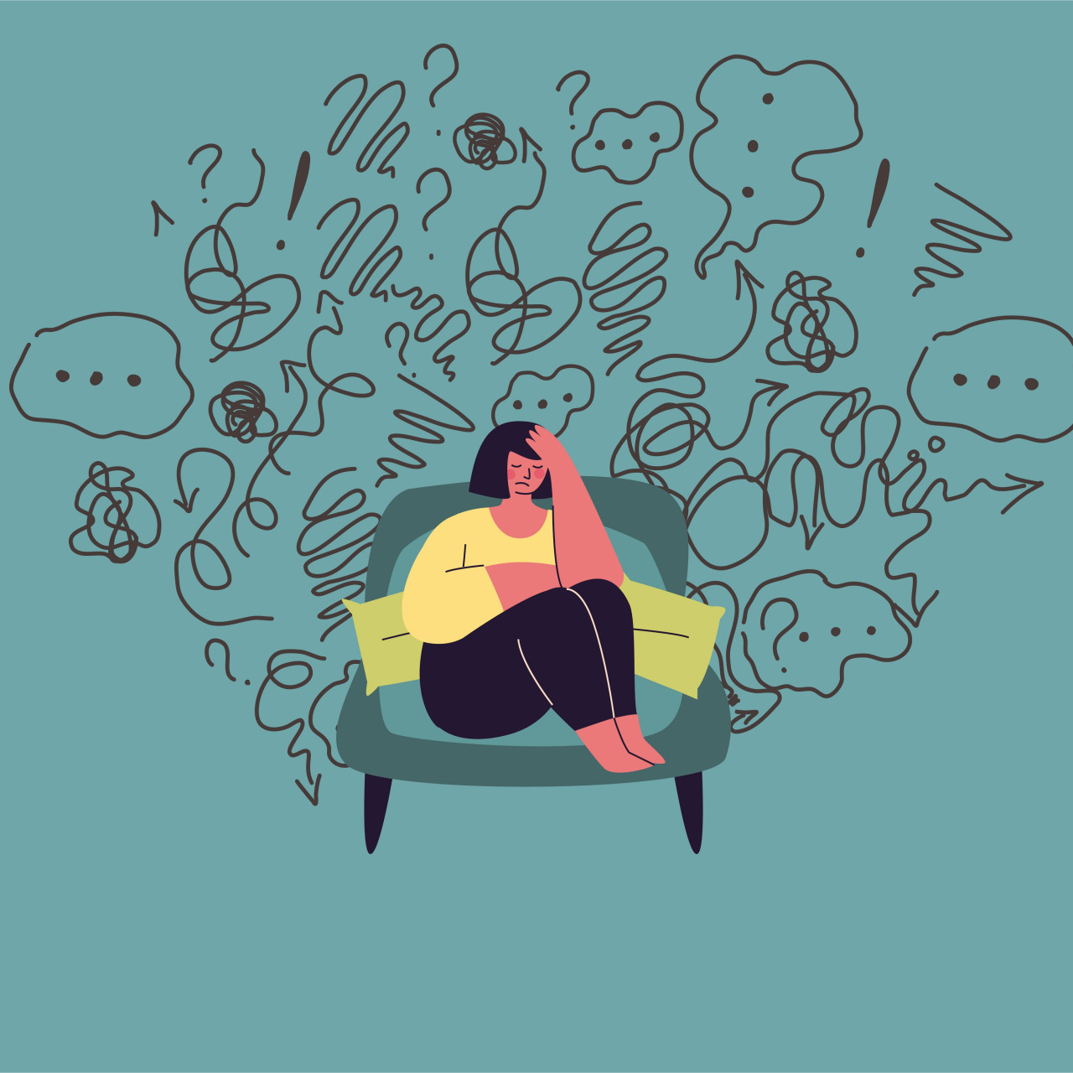

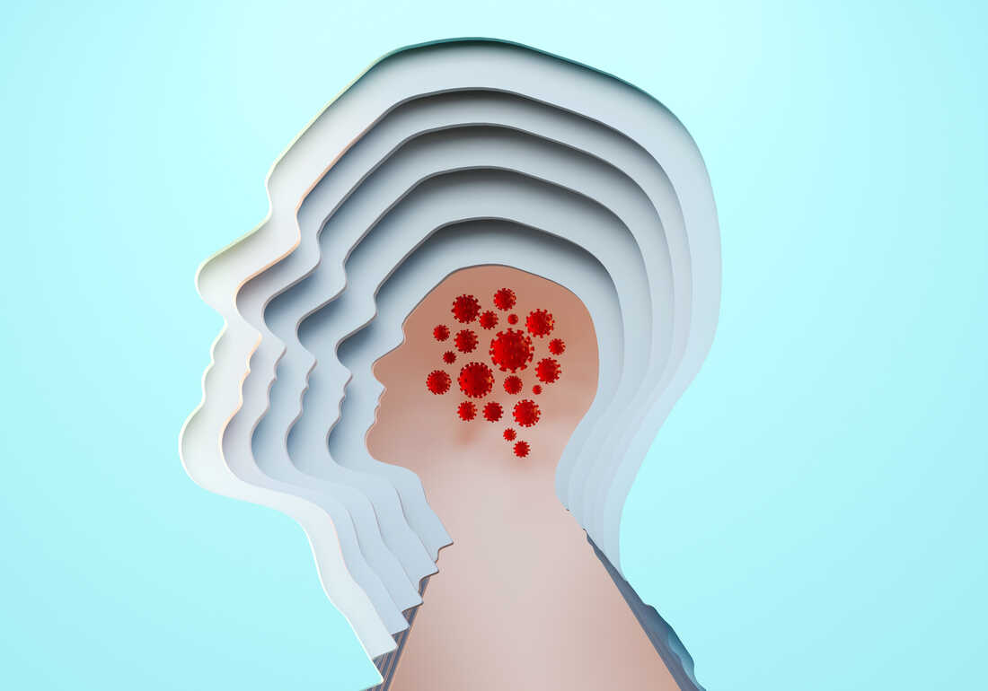
www.caraway.com/practicalstotry
Explore
C
Register
Login
araway
Practicals to Try
Why is this happening?
Discusses how external factors might impact our mental health.
Recommended healthy habits
Discusses habits we can include to benefit our mental health.
How to grow my wellbeing?
Discusses methods to improve wellbeing long-term.
Notes:
Dark slate grey: #305252 Ash grey: #BFC8AD Mountbatten pink: #A28497
Redwood: #A96060 Mayablue: #79BEEE

Slide 56
www.caraway.com/practicalstotry
Explore
C
Register
Login
araway
Why is this happening?
Discusses how external factors might impact our mental health.
Recommended healthy habits
Discusses habits we can include to benefit our mental health.
How to grow my wellbeing?
Discusses methods to improve wellbeing long-term.
Sign up for our newsletter!
email
Submit
Careers | FAQ | Contact Us | Press
Notes:
Dark slate grey: #305252 Ash grey: #BFC8AD Mountbatten pink: #A28497
Redwood: #A96060 Mayablue: #79BEEE

Slide 57
www.caraway.com/helpinglovedones
Explore
C
Register
Login
araway
Helping Loved Ones
Notes:
Dark slate grey: #305252 Ash grey: #BFC8AD Mountbatten pink: #A28497
Redwood: #A96060 Mayablue: #79BEEE

Slide 58



www.caraway.com/helpinglovedones
Explore
C
Register
Login
araway
Helping Loved Ones
How do I start?
Discusses how we start helping others.
Am I really that impactful?
Discusses the extent to which we can impact others.
Improving as a community!
Discusses how the community as a whole can support each other.
Notes:
Dark slate grey: #305252 Ash grey: #BFC8AD Mountbatten pink: #A28497
Redwood: #A96060 Mayablue: #79BEEE

Slide 59
www.caraway.com/helpinglovedones
Explore
C
Register
Login
araway
How do I start?
Discusses how we start helping others.
Am I really that impactful?
Discusses the extent to which we can impact others.
Improving as a community!
Discusses how the community as a whole can support each other.
Sign up for our newsletter!
email
Submit
Careers | FAQ | Contact Us | Press
Notes:
Dark slate grey: #305252 Ash grey: #BFC8AD Mountbatten pink: #A28497
Redwood: #A96060 Mayablue: #79BEEE

Slide 60
Learn about Jaleesa!
www.caraway.com/facebook
Explore
C
Register
Login
araway
Redirecting you to Facebook…
Careers | FAQ | Contact Us | Press
Notes:
Dark slate grey: #305252 Ash grey: #BFC8AD Mountbatten pink: #A28497
Redwood: #A96060 Mayablue: #79BEEE

Slide 61
Learn about Jaleesa!
www.caraway.com/twitter
Explore
C
Register
Login
araway
Redirecting you to Twitter…
Careers | FAQ | Contact Us | Press
Notes:
Dark slate grey: #305252 Ash grey: #BFC8AD Mountbatten pink: #A28497
Redwood: #A96060 Mayablue: #79BEEE

Slide 62
Learn about Jaleesa!
www.caraway.com/instagram
Explore
C
Register
Login
araway
Redirecting you to Instagram…
Careers | FAQ | Contact Us | Press
Notes:
Dark slate grey: #305252 Ash grey: #BFC8AD Mountbatten pink: #A28497
Redwood: #A96060 Mayablue: #79BEEE

